Slide 1
Chapter Sixteen
Working with Windows 7

Slide 2


220-902 Objectives Covered
1.1 Compare and contrast various features and requirements of Microsoft Operating Systems (Windows 7).
1.2 Given a scenario, install Windows PC operating systems using appropriate methods.
1.4 Given a scenario, use appropriate Microsoft operating system features and tools.
1.5 Given a scenario, use Windows Control Panel utilities.
1.6 Given a scenario, install and configure Windows networking on a client/desktop.

Slide 3
Windows 7 Editions
Windows 7 was released in six different editions; only three are available in the retail channel (Windows 7 Home Premium, Windows 7 Professional, and Windows 7 Ultimate).
Windows 7 Enterprise offers more features than Professional and less than Ultimate is licensed with a Software Assurance contract and not available in the retail channel; for all intents and purposes, Ultimate and Enterprise are functionally identical.
Windows 7 Starter was created for OEMs to install on netbooks.
Windows 7 Home Basic, is not listed on the CompTIA objectives and is marketed only in emerging technology countries.

Slide 4
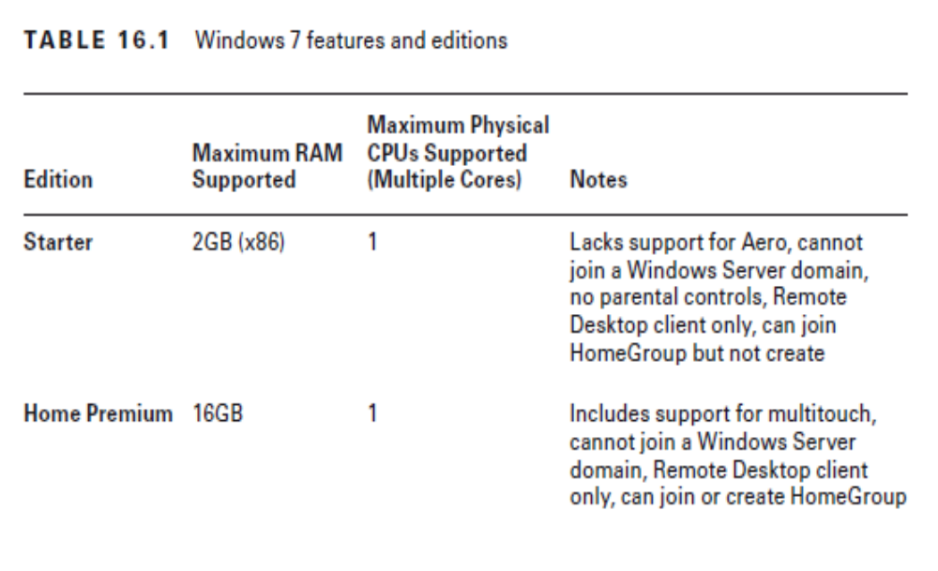
Notes:
Windows Starter does not have a 64-bit version

Slide 5
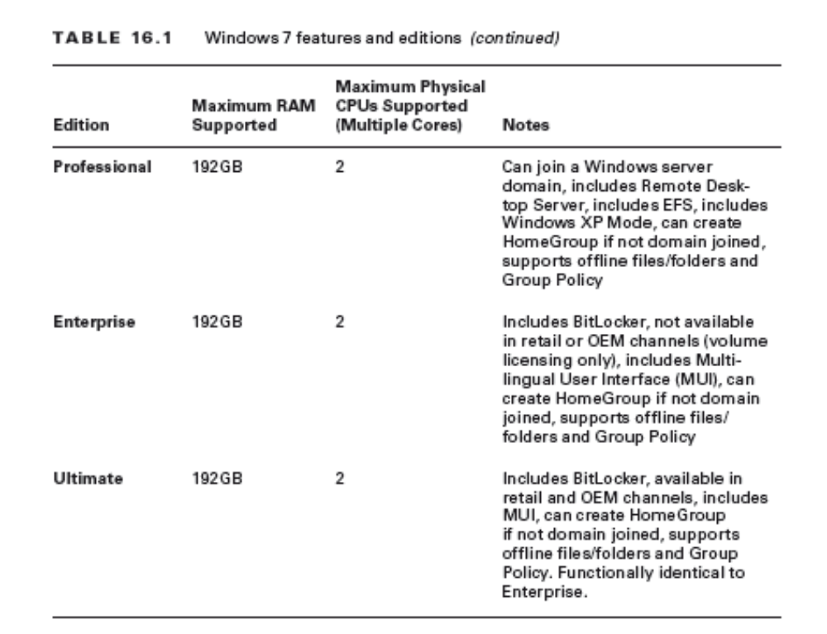
Notes:
There are 32-bit and 64-bit versions available for each of the editions listed except
Starter

Slide 6
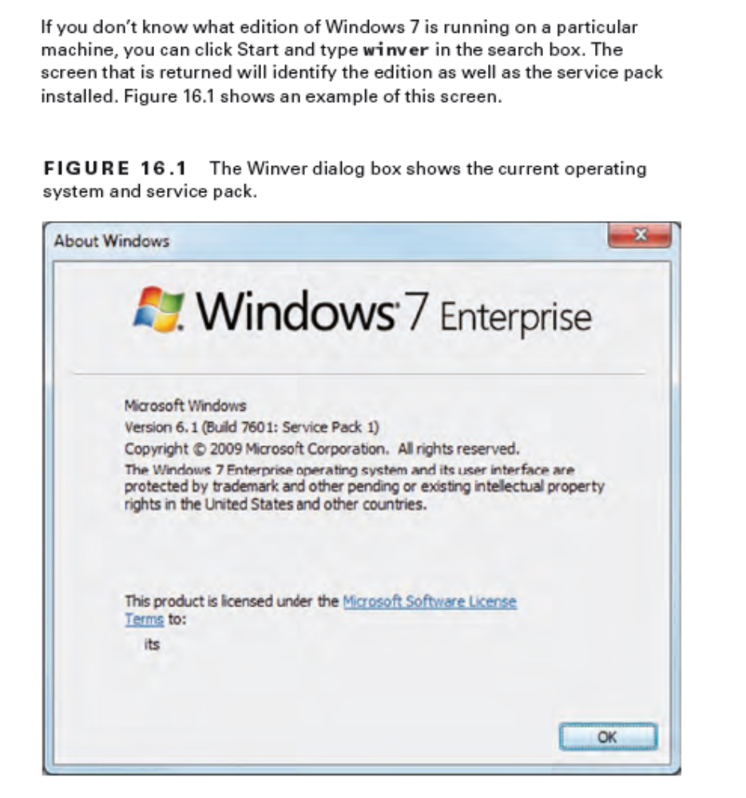

Slide 7
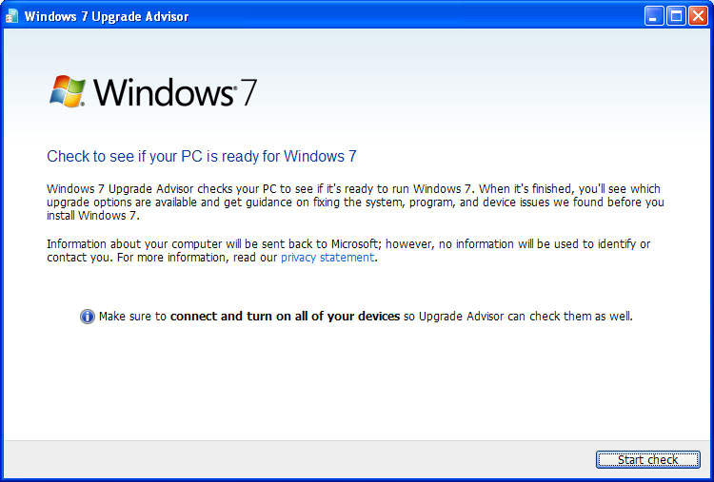
Windows 7 Upgrade Advisor
http://windows.microsoft.com/en-US/windows/downloads/upgrade-advisor
Notes:
Windows upgrade OS advisor: These are Microsoft utilities, either called Upgrade Advisor (Windows 7) or Upgrade Assistant (Windows 8/8.1) that check your current configuration and report what you need to take into
account (update, abandon, etc.) before upgrading to a newer OS.

Slide 8
Upgrade Options
In place upgrades: upgrade is done without removing the existing OS (the opposite - clean install)
Compatibility tools: These are used to keep legacy applications thinking they are running on a previous version of the OS after upgrade
Windows upgrade OS advisor: These are Microsoft utilities that check your current configuration and report what you need to take into account (update, abandon, etc.) before upgrading to a newer OS.

Slide 9
Windows 7 features
Aero The Aero interface offers a “glass” design that includes translucent windows
Gadgets These are mini programs, introduced with Windows Vista, which can be placed on the Desktop, allowing them to run quickly and personalize the PC

Slide 10
Windows 7 features
No Sidebar - Windows 7 did away with the Sidebar, and the gadgets are now placed directly on the Desktop.
User Account Control The UAC prevents unauthorized changes to the computer by prompting for permission to continue or requiring administrator password

Slide 11
Windows 7 features
BitLocker - allows you to use drive encryption to protect files, including those needed for startup and logon.
Unlike Encrypting File System (EFS), which enables you to encrypt individual files, BitLocker encrypts the entire drive
Notes:
For removable drives, BitLocker To Go provides the same encryption technology to help prevent unauthorized access to the files stored on them.
EFS can be used by all users (whereas BitLocker can be turned on only by administrators) and does not require any special hardware

Slide 12
Windows 7 features
Shadow Copy The Volume Shadow Copy Service creates copies from which you can recover should a file be accidentally deleted or overwritten

Slide 13
Windows 7 features
ReadyBoost This feature allows you to use free space on a removable drive to speed up a system by caching content.
Compatibility Mode – Older OS
XP Mode - Windows XP Mode included with Win 7 Pro, Enter. And Ultimate
Notes:
In Windows 7, ReadyBoost can work with a USB drive, flash memory, SD card, or CompactFlash drive.
Compatibility Mode - Choose Start ➢ Control Panel ➢ Programs, and then click Run Programs Made For Previous Versions of Windows
XP Mode - http://windows.microsoft.com/en-US/windows7/install-and-use-windows-xp-mode-in-windows-7
XP Mode will run much better if hardware-assisted virtualization can be enabled

Slide 14
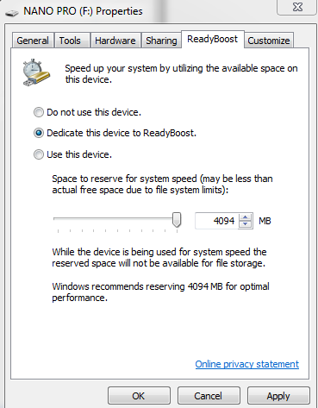
Windows 7 Features
ReadyBoost
Notes:
Right Click USB drive ---- Properties ----- ReadyBoost

Slide 15
Windows 7 features
Windows Defender Windows 7 includes the Windows Defender antispyware program.
Windows Firewall Windows 7 incorporates Windows Firewall, which can be used to stop incoming and outgoing traffic

Slide 16
Windows 7 features
Pinning to the Taskbar – Right click application
Windows Taskbar This has been redesigned to include thumbnail previews
Snap aka Aero Snap, is a quick way to resize windows on the Desktop and work with side-by-side apps – True Side-by-side mirroring
Notes:
Thumbnail is a term used by graphic designers and photographers for a small image representation of a larger image, usually intended to make it easier and faster to look at or manage a group of larger images
Check Aero Shake – Grab an open application and shake it to clear the other open apps from view

Slide 17
Windows 7 Features
HomeGroup simplified home work with permission levels
Windows Search Instantly find anything on your PC as soon as you start typing into the search
Windows Touch adds touchscreen functionality to the operating system
Notes:
HomeGroup - allows you to share files and prevent changes from being made to those files by those sharing them (unless you give them permission to do so).

Slide 18
Windows Features
Libraries You can logically (as opposed to physically) group files and folders that are not in the same location and make them appear as if they are
Notes:
To create a new library
Click the Start button , click your user name (which opens your personal folder), and then, in the left pane, click Libraries.
In Libraries, on the toolbar, click New library.
Type a name for the library, and then press Enter.
Right Click the Library, click Properties, click Include Folder to add a new Folder to the Library

Slide 19
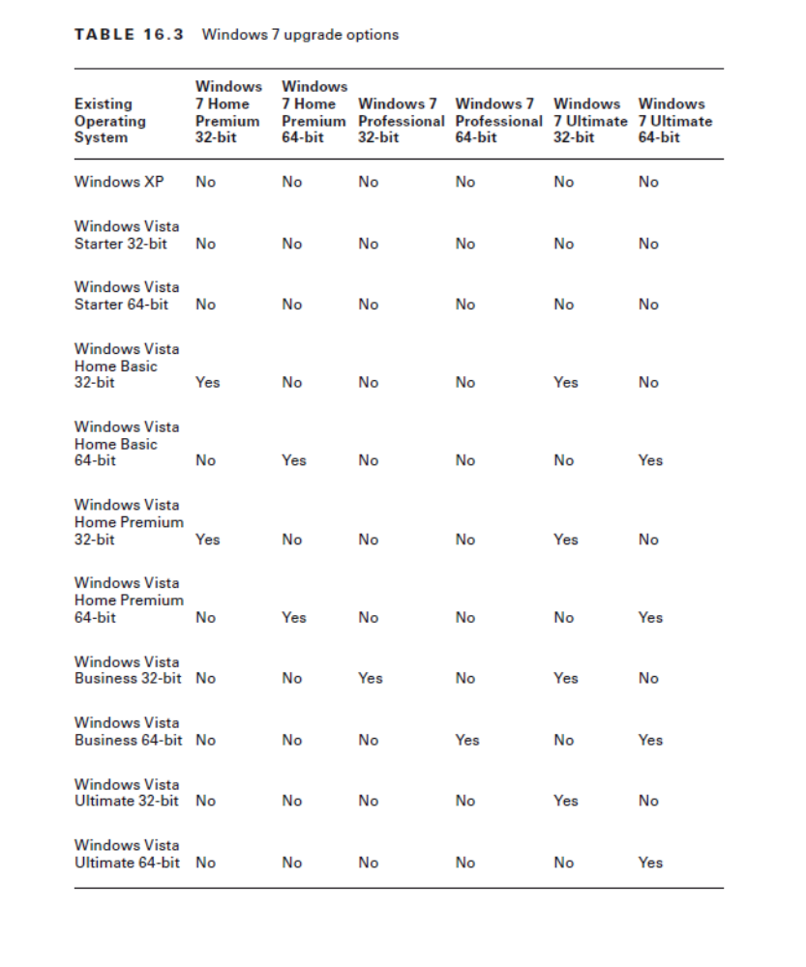
Notes:
Upgrade and Clean Install
Windows 7 can be installed as an upgrade or a clean installation, which is accomplished with the Custom option (think custom = clean).
When you choose Custom, you can choose whether or not to format the hard disk.
If you choose not to format the hard disk, the old operating system is placed in a folder called WINDOWS.OLD; if you choose to format, the
Custom option will erase your files, programs, and settings.

Slide 20
Summarizing the Upgrade Table
Older version | Upgradable to Windows 7 version
Windows XP / Vista Starter | Not updgradable
Vista Home Basic / Vista Home Premium | Win 7 Premium and Ultimate
Windows Vista Business | Win 7 Professional and Ultimate
Windows Vista Ultimate | Windows 7 Ultimate
***** Cannot upgrade from one bit to another i.e. 32bit to 64 bit or vice versa ****

Slide 21
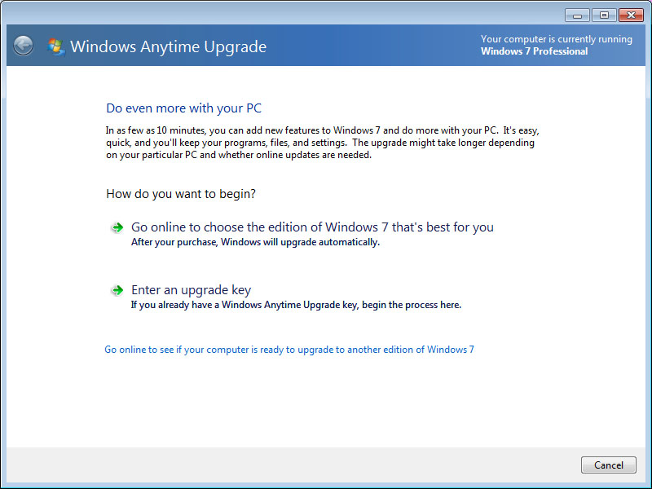
Windows Anytime Upgrade
Notes:
Microsoft created the Windows 7 Upgrade Advisor to help with the upgrade to this operating system.
You can download the advisor from www.microsoft.com/downloads
It will scan your hardware, devices, and installed programs for any known compatibility issues.
You can also always check hardware in the Windows 7 Compatibility Center at: https://www.microsoft.com/en-us/windows/compatibility/compatcenter/home

Slide 22
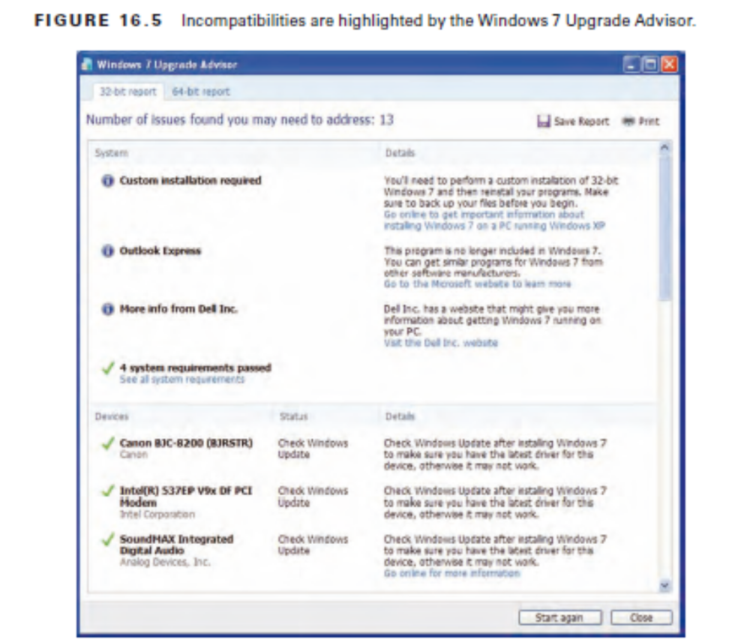
Notes:
After all incompatibilities have been addressed, the upgrade can be started from an installation disc or from a download
It is highly recommended that after the installation is complete, you run Windows Update to get the latest drivers.
Microsoft Windows User State Migration Tool (USMT) allows you to migrate user file settings related to the applications, Desktop configuration, and accounts
Version 5 - https://technet.microsoft.com/en-us/library/hh824913.aspx

Slide 23
Installing more than one PC
Use a automated tool
Microsoft Assessment and Planning (MAP) Toolkit - can be downloaded from the Microsoft Download Center
MAP gets an inventory of computers on your network and plan a rollout of the OS

Slide 24
Key Boot Files
BOOTMGR
BCD
WINLOAD.EXE
NTOSKRNL.EXE
WINRESUME.EXE
System files
  HAL.DLL
  SMSS.EXE
  WINLOGON.EXE
  LSASS.EXE
Notes:
BOOTMGR The Windows Boot Manager (BOOTMGR) bootstraps the system. In other
words, this file starts the loading of an OS on the computer.
BCD The Boot Configuration Data (BCD) holds information about OSs installed on the
computer, such as the location of the OS files.
WINLOAD.EXE The program used to boot Windows 7. It loads the operating system kernel
(NTOSKRNL.EXE).
WINRESUME.EXE If the system is not starting fresh but resuming a previous session, then
WINRESUME.EXE is called by the BOOTMGR.
NTOSKRNL.EXE The Windows OS kernel.
System files In addition to the previously listed files, Windows needs a number of files
from its system directories (for example, SYSTEM and SYSTEM32),

Slide 25
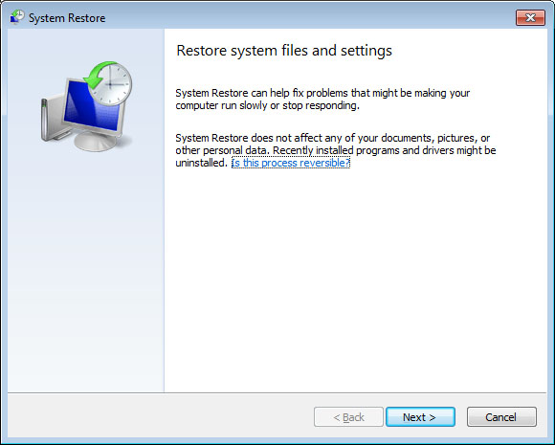
System Restore

Slide 26
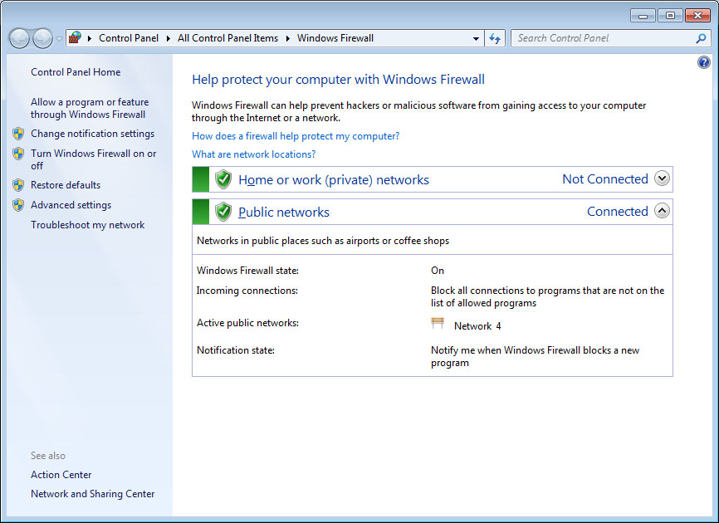
Windows Firewall
Notes:
Start ➢ Control Panel ➢ Windows Firewall
Firewall - blocks access from the network
Network-based (more secure) vs Host-based
it is divided into separate settings for private networks and public networks as well as domain networks
Exceptions - Windows Firewall will block incoming network connections except for the programs and services that you choose to allow
through. Includes Programs and ports

Slide 27
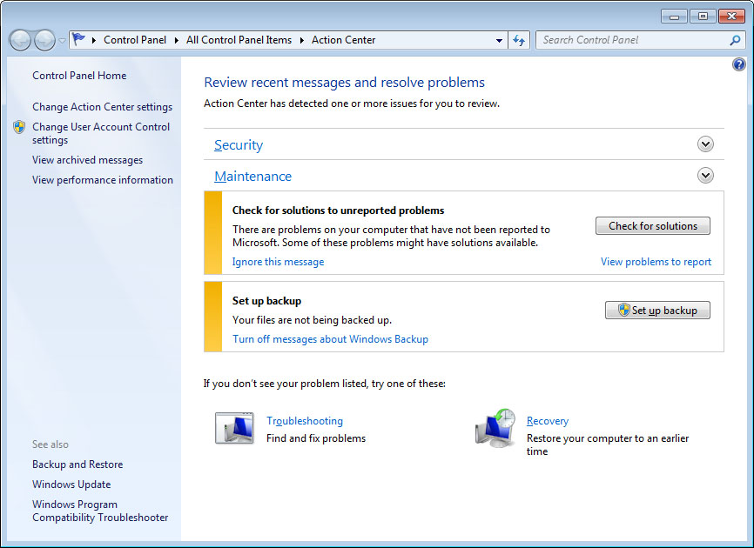
Action Center
Notes:
Windows Defender can identify spyware, and it is included with all versions of Windows 7
Start ➢ Control Panel ➢ Windows Defender
Although it still includes security, it has been expanded to include such maintenance issues as problem reports and backup settings

Slide 28
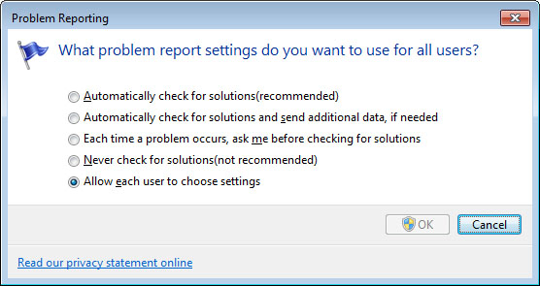
Error Reporting
Notes:
4 Options available under Error reporting

Slide 29
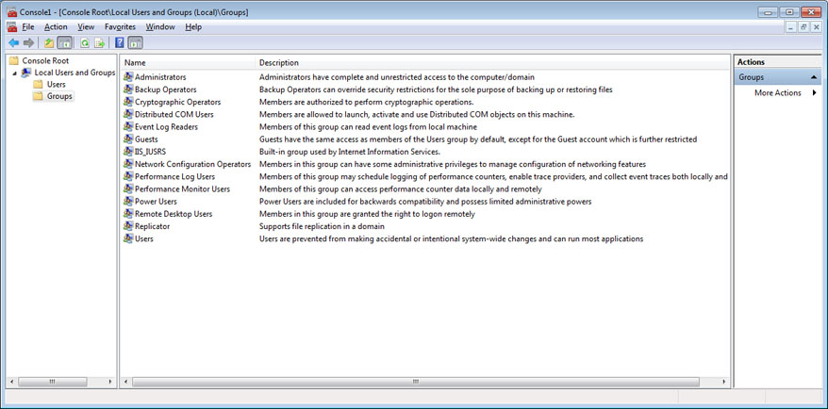
Users and Groups
Notes:
MMC.exe
File ➢ Add/Remove Snap-in (Add Local Users and Groups if not visible)
Local Users And Groups is not available for Windows 7 editions lower than Professional. In all other editions, you must manage user accounts using the User Accounts applet in Control Panel, and you cannot create or manage groups

Slide 30
Administrative Tools

Slide 31
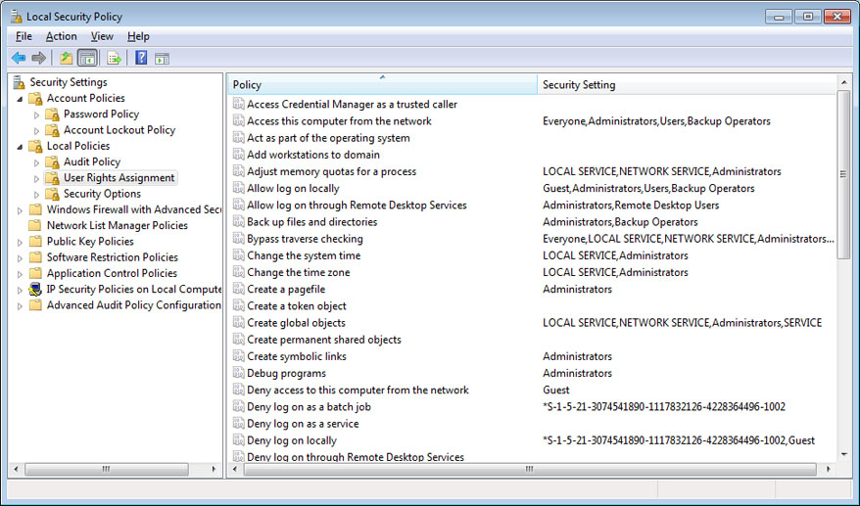
Local Security Policy
Notes:
Start ➢ Run and then enter secpol.msc
This feature is not available for Windows 7 in any editions other than Windows 7 Professional, Windows 7 Ultimate, and Windows 7 Enterprise
You can change the default system settings for many security-related features hidden deep within the Registry
Page 806 shows more scenarios

Slide 32
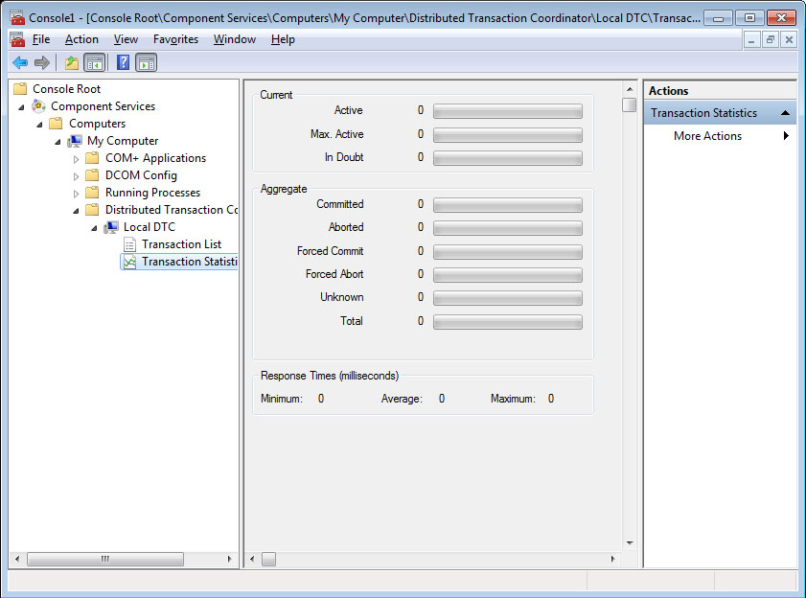
Component Services
Notes:
Component Services is an MMC snap-in in Windows 7 that allows you to administer and deploy, component services and configure behavior like security
Start ➢ Control Panel ➢ Administrative Tools ➢ Component Services).

Slide 33
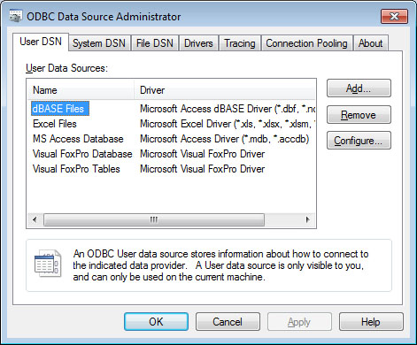
Data Sources
Notes:
ODBC Data Source Administrator—Start ➢ Control Panel ➢ Administrative Tools ➢ Data Sources (ODBC)
Allows you to interact with database management systems

Slide 34
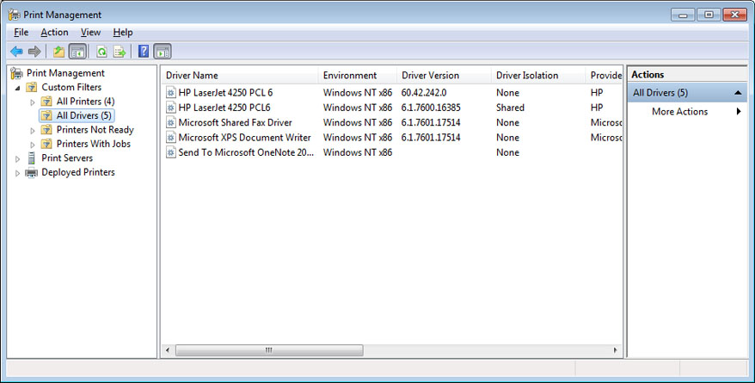
Print Management
Notes:
Print Management (Start ➢ Control Panel ➢ Administrative Tools ➢ Print Management) allows you to manage multiple printers and print servers from a single interface

Slide 35
Unique Control Panel Utilities
4 Applets unique to Windows 7:
Action Center
Home Group
RemoteApp and Desktop Connection
TroubleShooting
Notes:
HomeGroup
The purpose behind HomeGroup (Start ➢ Control Panel ➢ HomeGroup) is to simplify home networking and, more specifically, the sharing of files and printers
RemoteApp and Desktop Connections
This applet (Start ➢ Control Panel ➢ RemoteApp And Desktop Connections) in Windows 7 is used, as the name implies, to access remote computers and virtual machines made available over the network through port 3389 can run a remote application as if it were installed on the local machine
Troubleshooting
This applet (Start ➢ Control Panel ➢ Troubleshooting) - provides a simple interface to use to attack many common problems
All links preceded by a shield require administrator permissions to run, and they are often tied to UAC prompts before they will continue

Slide 36
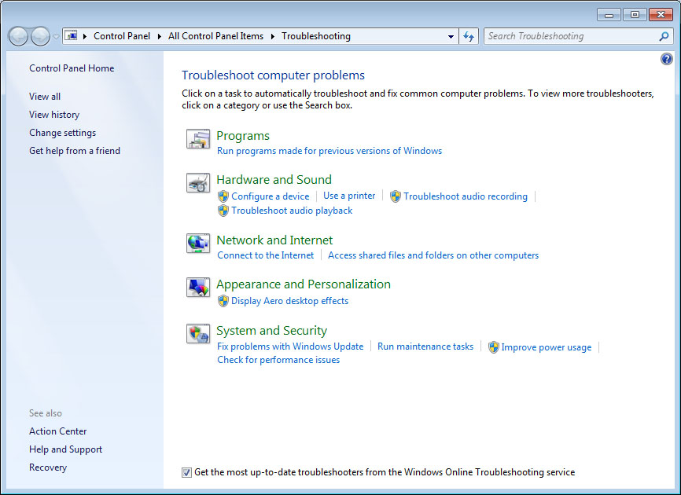
Troubleshooting
Notes:
The Windows Memory Diagnostics Tool (Start ➢ Control Panel ➢ Administrative Tools ➢ Windows Memory Diagnostics) can be used to check a system for memory problems.
For the tool to work, the system must be restarted.

Slide 37
Networking Connection Options
Connect to the Internet
Set up a wireless router or access point
Manually connect to a wireless network
Set up a wireless ad hoc (computer-to-computer) network
Set up a dial-up connection
Connect to a workplace
Notes:
Connect to the Internet – Connection to server intended to provide Internet access. This includes wireless, broadband, and dial-up.
Set up a wireless router or access point - If the wireless device will be connected to this machine, this is the option to use.
Manually connect to a wireless network (this option is only visible if a wireless adapter is installed) - wireless network already in place and the device (router and so forth) is not directly connected
to this machine, then use this option
Set up a wireless ad hoc (computer-to-computer) network (this option is only visible if a wireless adapter is installed) - peer-to-peer resource sharing / temporary connection.
Set up a dial-up connection If you live in the middle of nowhere and need dial-up modem for internet, then this is the option to select.
Connect to a workplace If you need to connect to a virtual private network (VPN) from a remote location, this is the option to use.
*** If you choose one of the first two, network discovery is on by default, allowing you to see other computers and other computers to see you
***A wireless wide area network (WWAN) connection is one that uses cellular to connect the host to the network

Slide 38
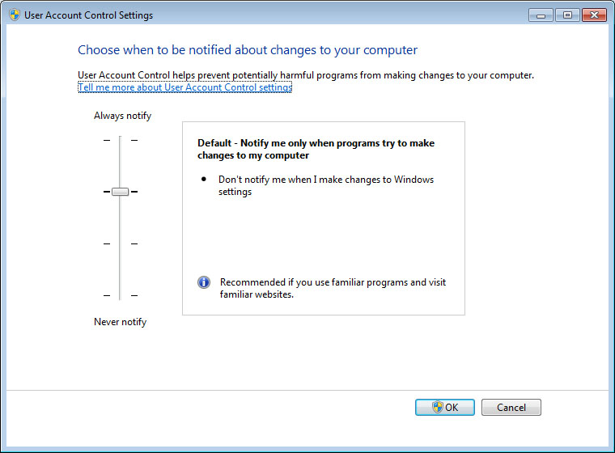
UAC Settings
Notes:
Start ➢ Control Panel ➢ User Accounts ➢ Change User Account Control Settings
Windows 7 went beyond Windows Vista in configurability, and it allows you to choose between four UAC settings:
Always Notify
Notify me only when programs try to make changes to my computer (the default)
Notify me only when programs try to make changes to my computer (do not dim my desktop)
Never Notify

